Slide 1
Might consensus seekers produce polarized society? (And something more on ABM)
František Kalvas, University of West Bohemia (Czech Republic, kalvas@kss.zcu.cz);
Ashwin Ramaswamy, Independent Researcher (India, ashwin.ramaswamy.92@gmail.com);
Ashley Sanders-Jackson, Michigan State University (USA, a.sanders.jackson@gmail.com);
Michael Slater, The Ohio State University (USA, slater.59@osu.edu)
The Ohio State University lecture, ZOOM, 2024 October 30th

Slide 2
Agent-based modeling (ABM)

Slide 3
Computational X and ABM
All fields have three pillars.
Each edvanced field X has: Theoretical X, Empirical X and Computational X.
These pillars are interrelated: we know relationship between Theoretical X and Empirical X.
Computational X offers novel methods of data gathering (e.g. web-scrapping) and data production (e.g. computer simulations).
Modeling and simulations are just part of Computational X. Agent-based modeling (ABM) is just part of modeling and simulations.
ABM is in same relationship to communication theory as mathematics to physics: ABM/math postulates axioms and study models and results stemming from them, physics/comm theory studies something real, decides whether these models and results are useful (Faymann lecture „what differs physics from mathematics“ https://www.youtube.com/watch?v=B-eh2SD54fM)

Slide 4
ABM
Agent ~ independent entity, no central control, variability (many co-existing species);
variables describing its state; senses its own states, senses states of other agents in the environment, senses environment; processes sensed states;
behaves/acts according processed states.
Environment ~ topological space, variables describing its state
Rules ~ we as researchers formulate them: for agents, for environment
Experiment ~ ABM allows us to do systematic thought experiments with model

Slide 5
ABM for theory development
We formulate rules according theories and implement them in computer code. It allows us:
Test theory – we can see whether ABM created according the theory behaves as theory predicts; generativist manifesto „If you didn‘t grow it, you didn‘t explain it!“
Fail fast – we might quickly test theory ideas without carrying out expensive empirical research.
Inspiration – known models/ABM might inspire us, they might show in action tested and validated models/principles, it might abridge gaps in our theory, it might show us new frontiers
Practical leading – it might awarn us of problems which we might find in empirical research, it might help us to design our experiments better or set our pay-offs in experiments
Real world insights – despite ABM is artificial, it might clarify how real world processes are possible

Slide 6
Example of toy ABM on opinion dynamic
Now I have to turn into modeling software NetLogo.
Let‘s play a little bit there with toy model I prepared just in two hours.

Slide 7
Main achievements of the project so far:
Project goal: to model the process of opinion polarization
Relevance for communication researchers: -- How does everyday interpersonal communication might lead to polarization? -- We usualy see networks everywhere, but we might offer stronger predictor of polarization.
-- We demonstrate usefulness of novel research/theory building method.
Main achievements:
1) Results – identity/communication norms and openness to different opinions drive polarization: also dimensions of opinion space decrease polarization, but average probability of speaking, conformity and structure of small-world network make no significant difference
2) Nonlinearity – identity/communication norms and openness to different opinions function nonlinearly: average polarization for certain sets of parameters is not representative, since these sets cause bifurcations – polarization is either high in some simulations or low but not average

Slide 8
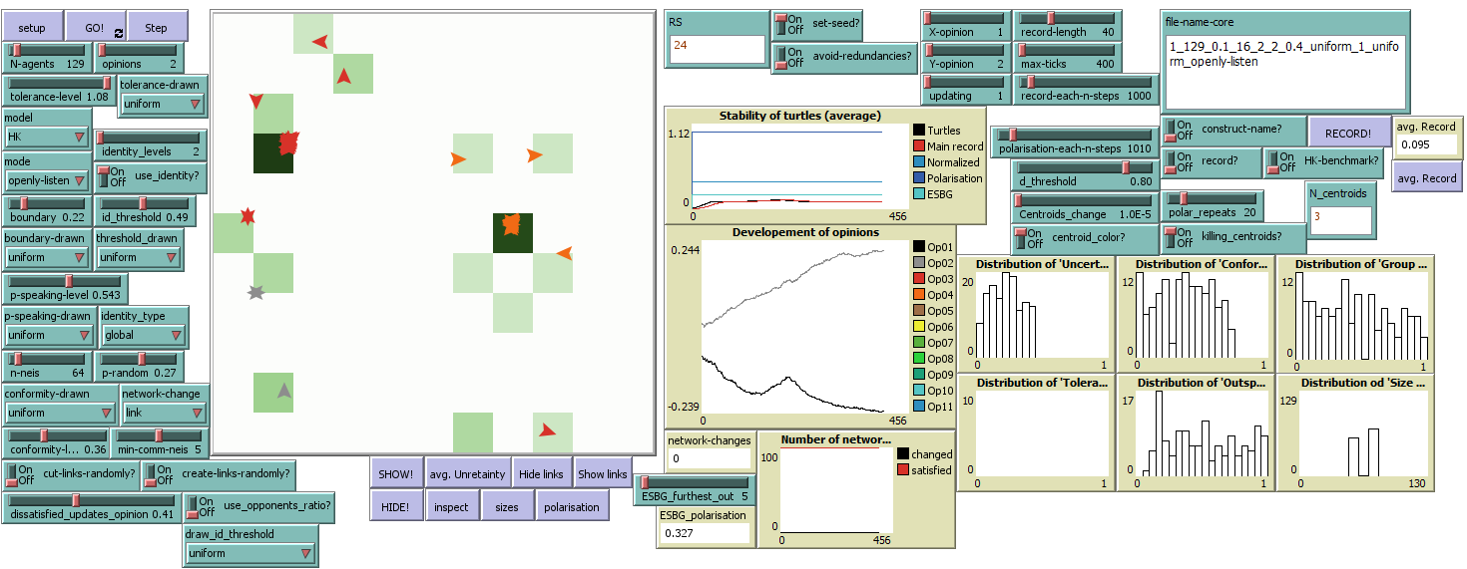
Our basic model

Slide 9
Basic model
Classical Hegselmann-Krause
Every agent speaks out its opinion.
Agents take into account only opinions inside BOUNDARY given by their opinion and openness to different opinions – step function is used.
Agents estimate concensus as average of listened opinions.
Agents update opinion – they ‚move‘ toward estimated consensus with speed given by their CONFORMITY (the higher conformity the faster and closer to consensus).
Both main parameters – margin of BOUNDARY and CONFORMITY – are constant across all agents
Everything happens in 1D opinion space – agents discuss just one issue.

Slide 10
Basic model
Advancements of Hegselmann-Krause in present model
We use more dimensions of opinion space than just 1D.
Agents speak out their opinion with a probability – not everyone speaks always.
Agents are connected with communication network (small-world) – they listen only to network neighbors.
Agents recognize identity groups according ‚Salience of Proximity in Identity Relevant Opinions‘ (SPIRO) – they listen only to their group members. This group is also proxy for the communication norms.
Margin of boundary, conformity, and speaking probability are random-unifomly distributed – parameters control population average of these variables.

Slide 11
Comparison of classical and advanced versions
Classical Hegselmann-Krause | Our model
Constant boundary | Random uniformly distributed boundary
Constant conformity (beta) | Random uniformly distributed conformity (beta)
One dimensional opinion space | Possibility of multiple dimensions
Difference in opinions as the only constraint | Euclidean distance in opinion space as one of constraints
No other constraints | Identity, communication network and speaking out as other constraints – agents consider only opinions from: (a) members of the same identity group, (b) who are also directly connected by edges of small-world communication network (i.e. they are neighbors), and (c) who speak their opinion out in present round of model run.

Slide 12
Basic model: Course of actions
Setup:
Position in opinion space, values of uncertainty/openness to different opinions, probability of speaking and conformity are randomly assigned to agents.
A round of model run:
Agents check constraints ( identity group ~ same or different group, openness to different opinions ~ distance in opinion space inside boundary, speaking ~ the other speaks, communication network ~ neighbor or not) and determine whom they listen to in the present round.
Agents find consesus of listened agents (average opinion) and moved towards it with speed given by the conformity.
Agents update communication network (rewiring link/neighborhood, non/randomly).

Slide 13
Identity recognition

Slide 14
Identity recognition
‚Global‘ identity recognition
1. Proximity of agents in opinion space are turned into weighted full network: p=1 ~ w=1; p=0 ~ w=0; p(1, 0) ~ w=p.
2. Then we reduce network followingly:
a. Edges with weight less than SPIRO are filtered out.
b. Nodes with one or zero edges are filtered out.
3. Then we perform Louvain on reduced network for community detection (maximization of edges within clusters, minimization of edges between clusters) – note: NetLogo uses Louvain that neglects weights.

Slide 15
Identity recognition
‚Global‘ identity recognition (continue)
4. Then we perform K-means clusters:
a. We use Louvain communities for definition of initial groups‘ centroids,
b. then we assign nodes/agents filtered in STEP 3 to nearest centroid,
c. we recompute centroids positions and check whether all agents are assigned to nearest centroid,
d. then we reassign agents wrongly associated and recompute centroids position until associations stabilize.
5. Identity group is then set of agents associated with same centroid.

Slide 16
Identity recognition
‚Individual‘ identity recognition
Each agent has its own randomly assigned value of SPIRO. The ideal then would be to run `Global identity recognition` for each agent, but it is computationally very demanding – Louvain is the most demanding part, speed of simulation slows down linearly with number of agents. So we:
Categorize individual SPIRO into few levels (2—10).
Then we perform `Global identity recognition` in each level of SPIRO. Speed of simulation slows down linearly only with number of levels.
It‘s not exact implementation of individual recognition of identity groups, but it is very good proxy.

Slide 17
Identity recognition

Slide 18
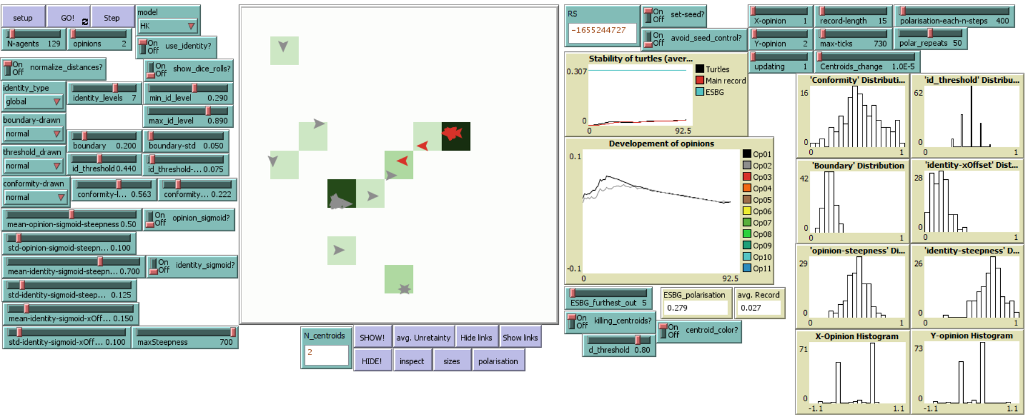
Identity recognition

Slide 19
Results

Slide 20
Results
METHODS
Netlogo¹. We utilize Netlogo, an agent-based modeling piece of software, to develop emergent systems to study the process of polarization
Hegselmann-Krause model (HK) ².
ESBG ³ measure of polarization (0-1 scale).
Stepwise regression. We completed a series of stepwise regression models to determine the impact of variables of interest on our ABM. We only display the final model on this handout.
REFERENCES:
Tisue, S., & Wilensky, U. (2004). NetLogo: Design and implementation of a multi-agent modeling environment. Proceedings of the Agent 2004 Conference on Social Dynamics: Interaction, Reflexivity and Emergence, Chicago, IL.
Hegselmann, R., & Krause, U. (2002). Opinion dynamics and bounded confidence models, analysis, and simulation. Journal of artificial societies and social simulation, 5(3).
Tang, T., Ghorbani, A., Squazzoni, F. et al. Together alone: a group-based polarization measurement. Qual Quant (2021). https://doi.org/10.1007/s11135-021-01271-y

Slide 21
Results
VARIABLES OF INTEREST
Opinions (1, 2, 4) indicating how many dimensions does the opinion space have.
Salience of proximity in identity relevant opinions (SPIRO) is measured using identity threshold (0-1 scale) which determines minimum similarity between two agents for them to be included in part of a community.
Openness to different opinions is measured using boundary (0-1 scale) with a boundary closer to 1 indicating a willingness to accept very different opinions and use them for updating own opinion.
Probability of speaking (0-1) with 1 indicating a greater probability of speaking.
Conformity level (0-1) with 1 indicating a greater conformity and a faster movement to seen concensus.
Rewiring (0-1) probability of rewiring edge of small-world network, with 1 indicating the network of interpersonal communication is close to random network, 0 indicating the clear small-world network.
Neighbors (1-128) number of neighbors in communication neighborhood.

Slide 22
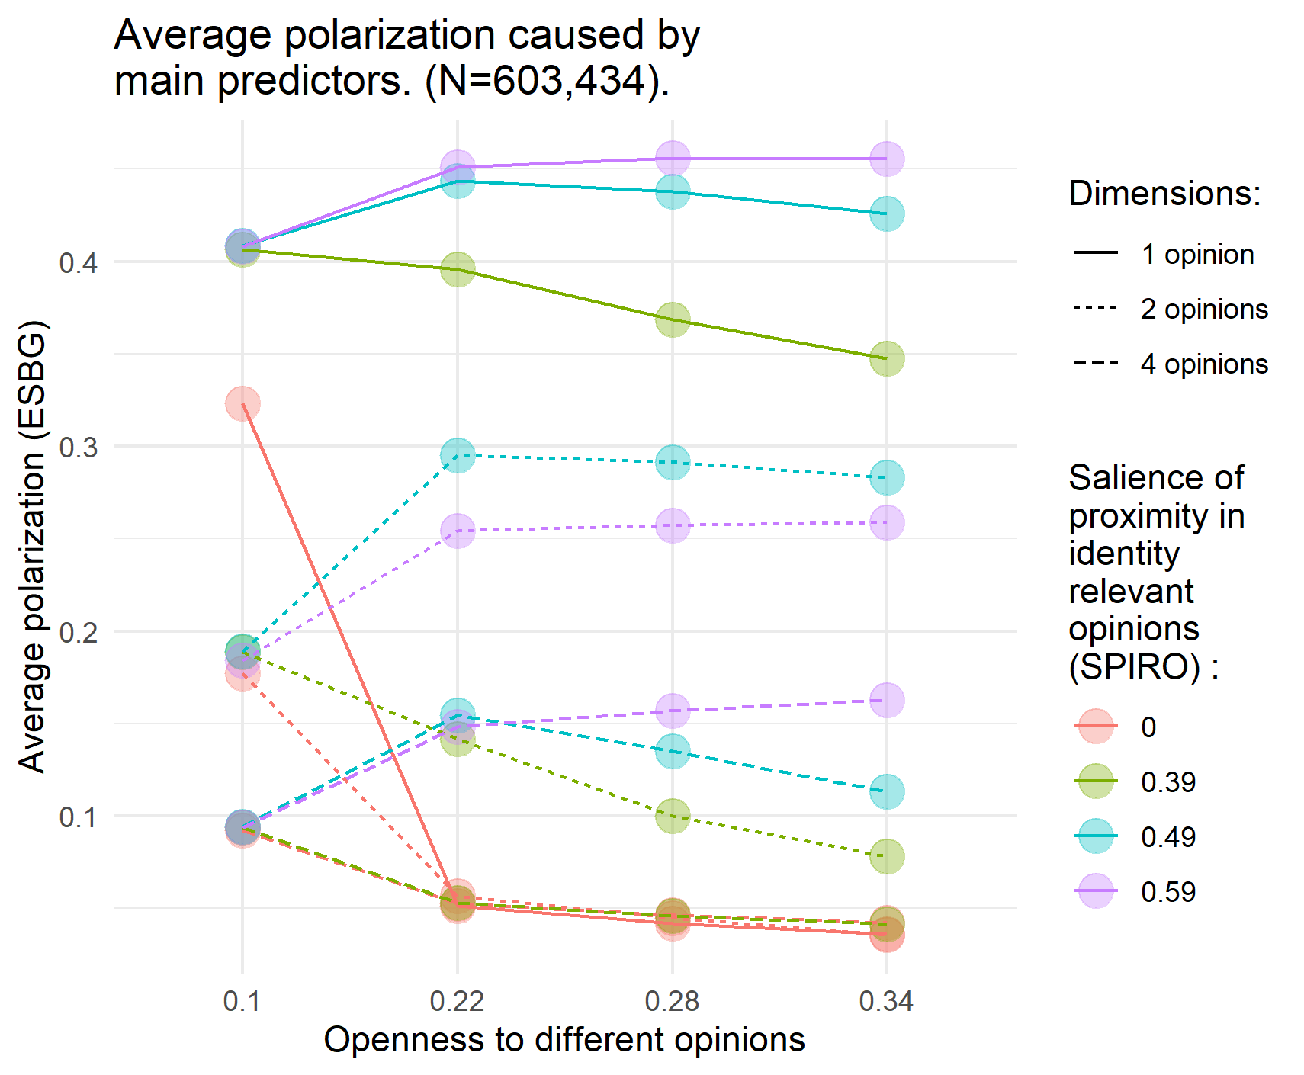
Results
Regression predicting contributors to polarization. (N=603,434; R²=51.6% ).
Variable | Coefficient
Opinions (2) | -0.159***
Opinions (4) | -0.244***
SPIRO (0.39) | 0.167***
SPIRO (0.49) | 0.263***
SPIRO (0.59) | 0.259***
Openness to diff. opinions | -0.194***
Probability of speaking | -0.012***
Conformity level | -0.003
Small-world: Rewiring | -0.003
Small-world: Neighbors | -0.0001***
Constant | 0.227***
*** significant at the .001 level

Slide 23
Nonlinearity

Slide 24
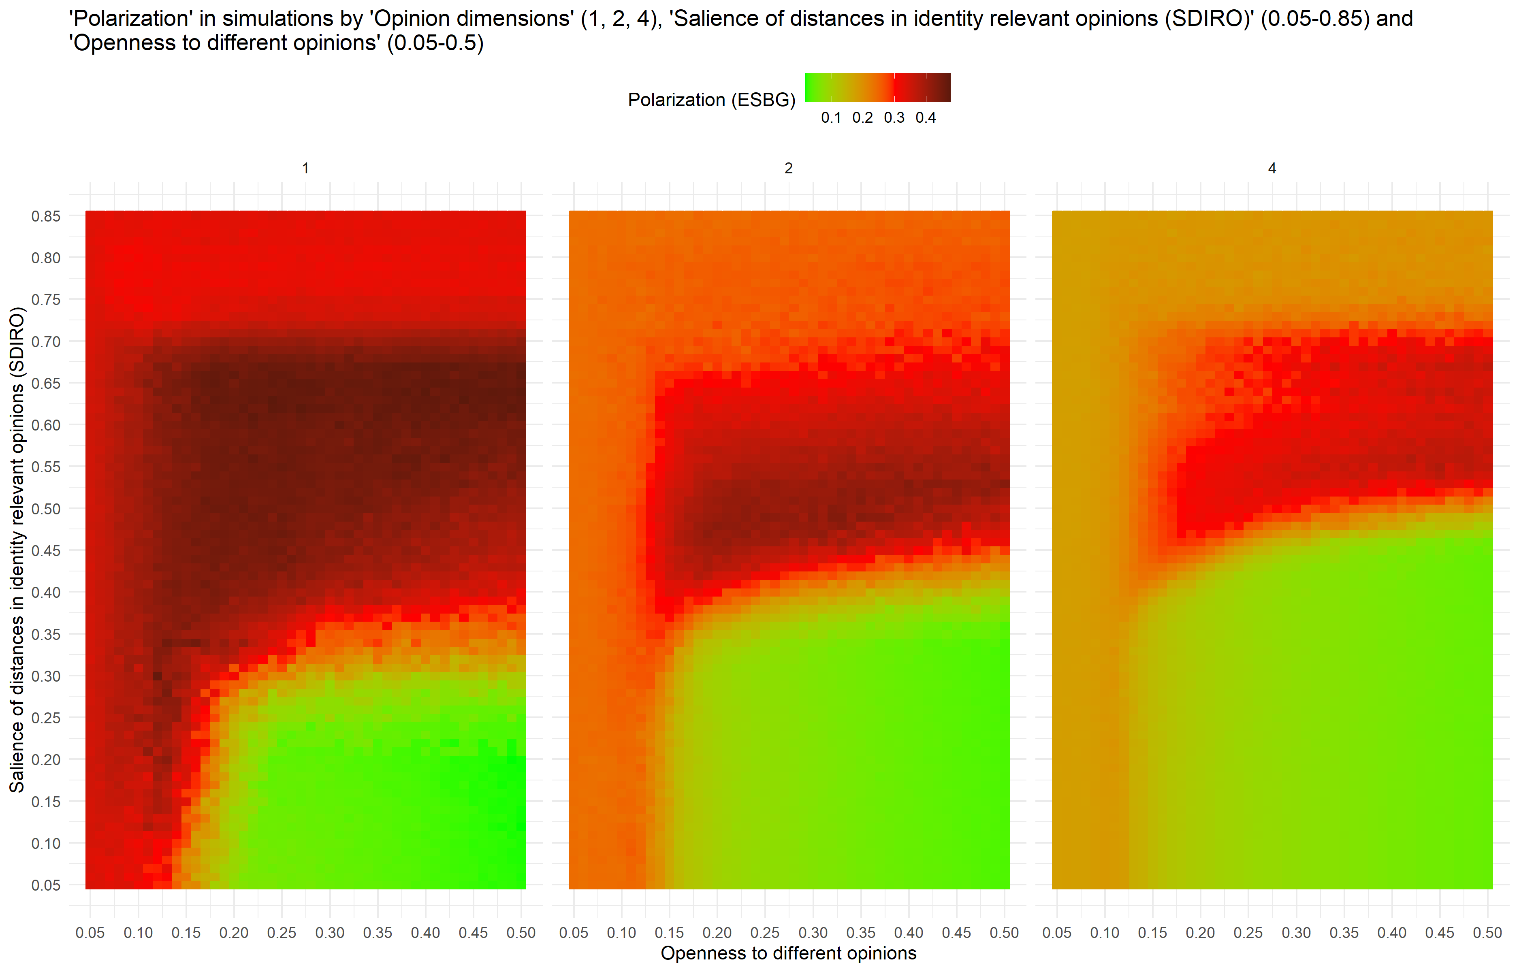

Slide 25
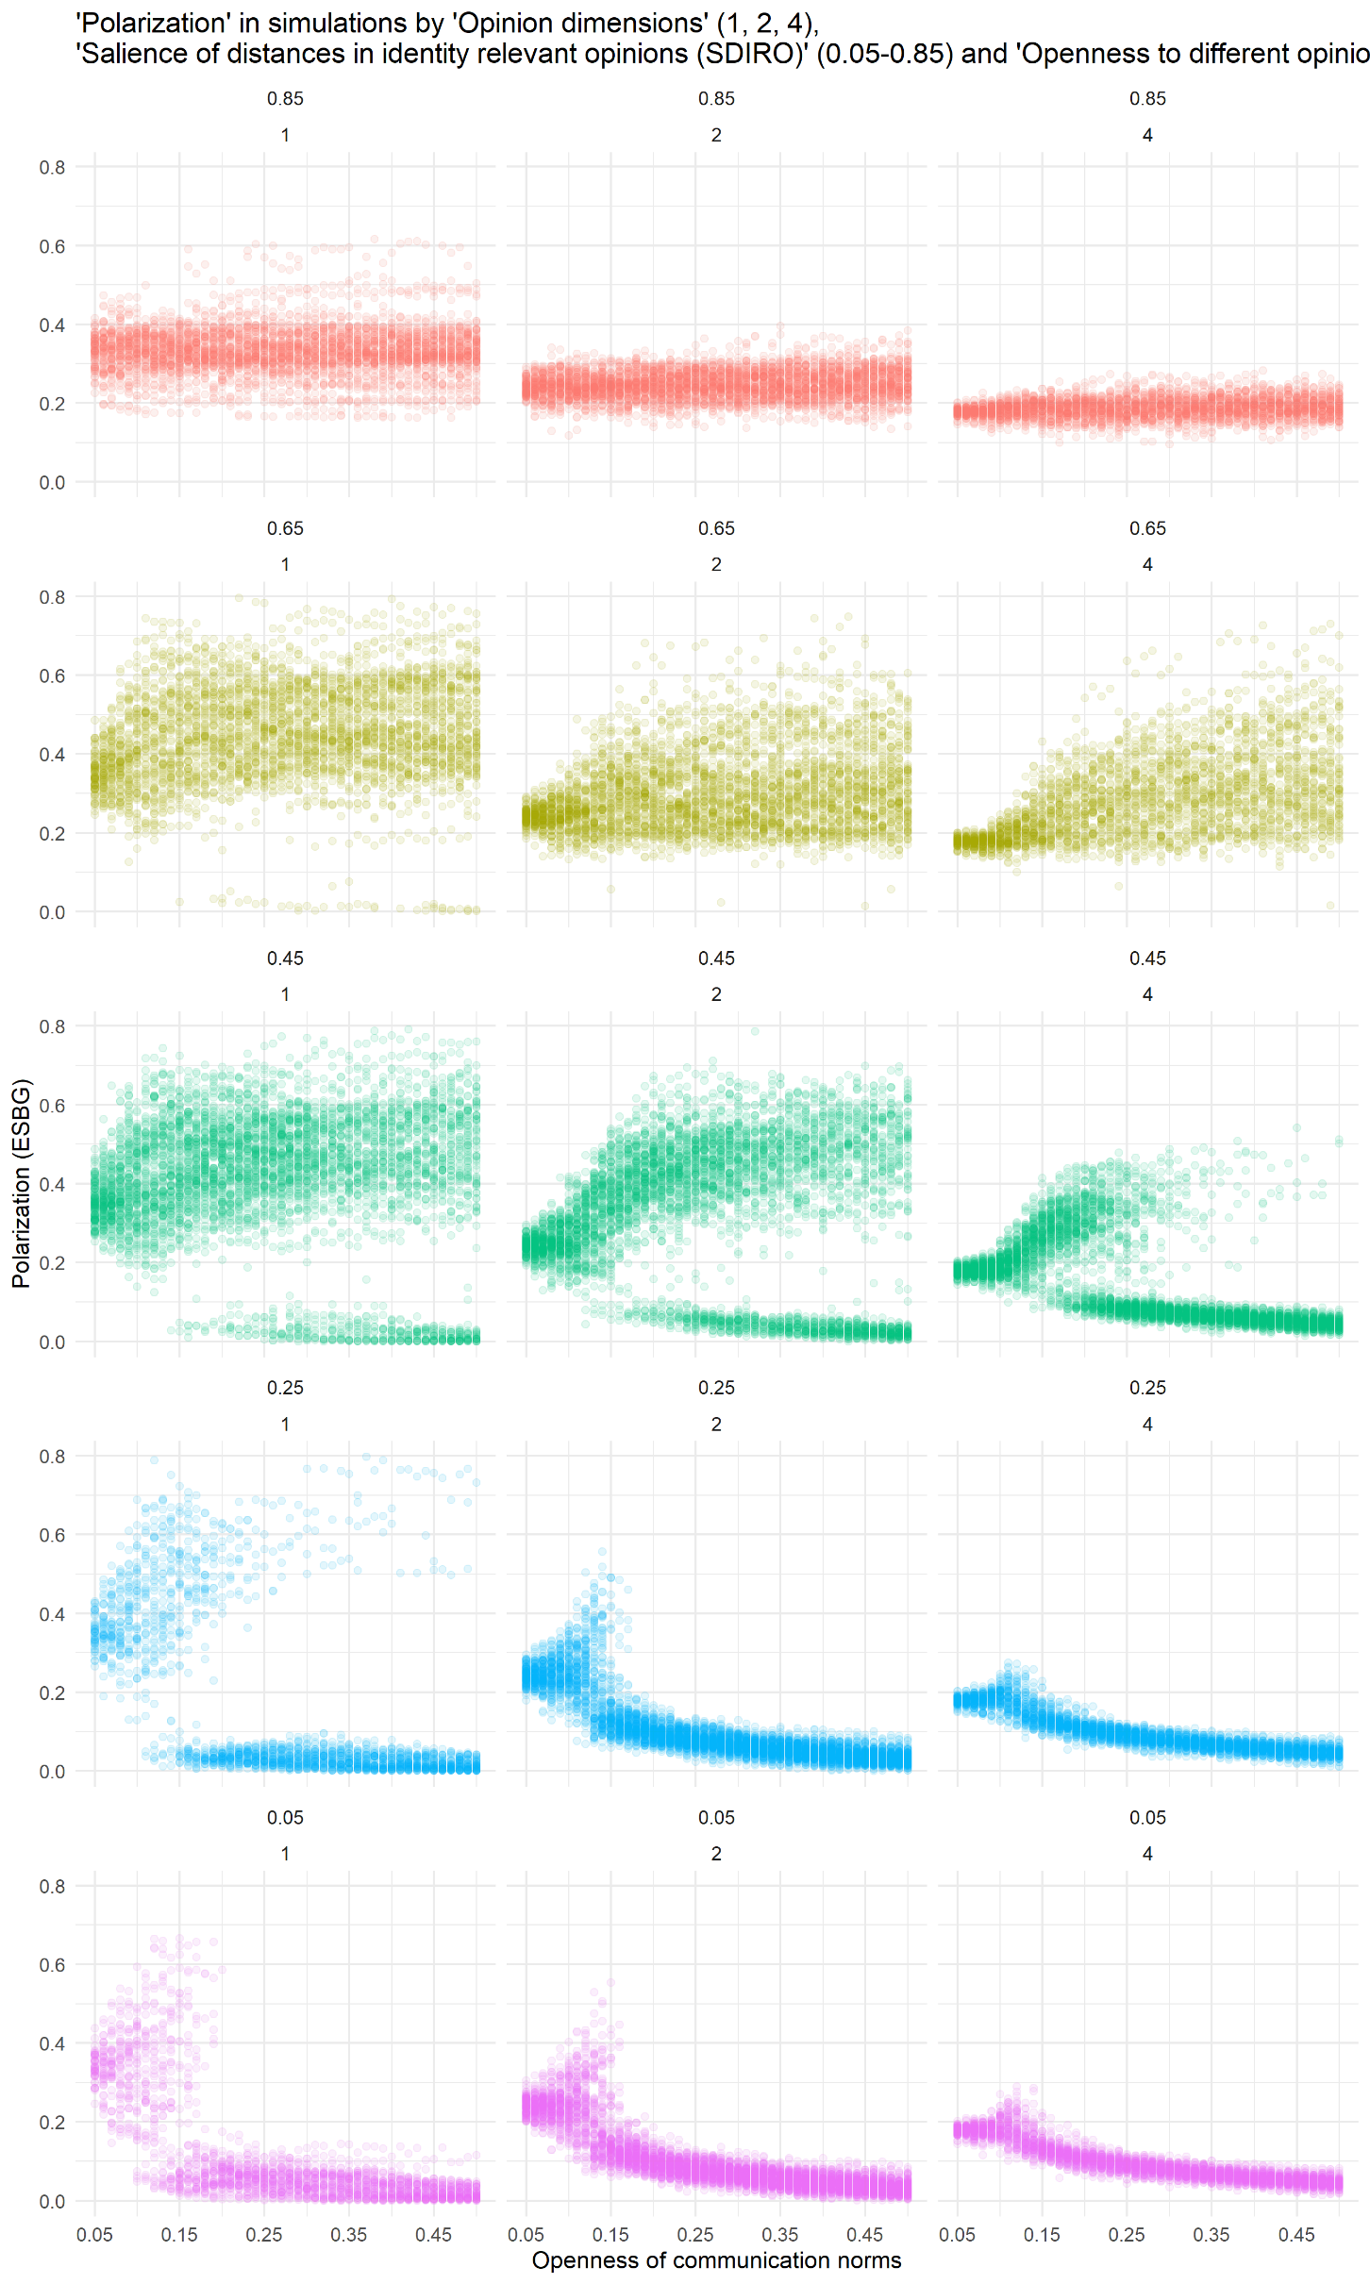
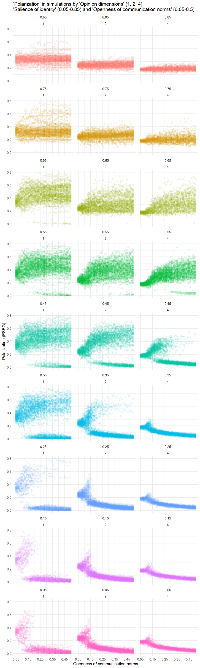

Slide 26
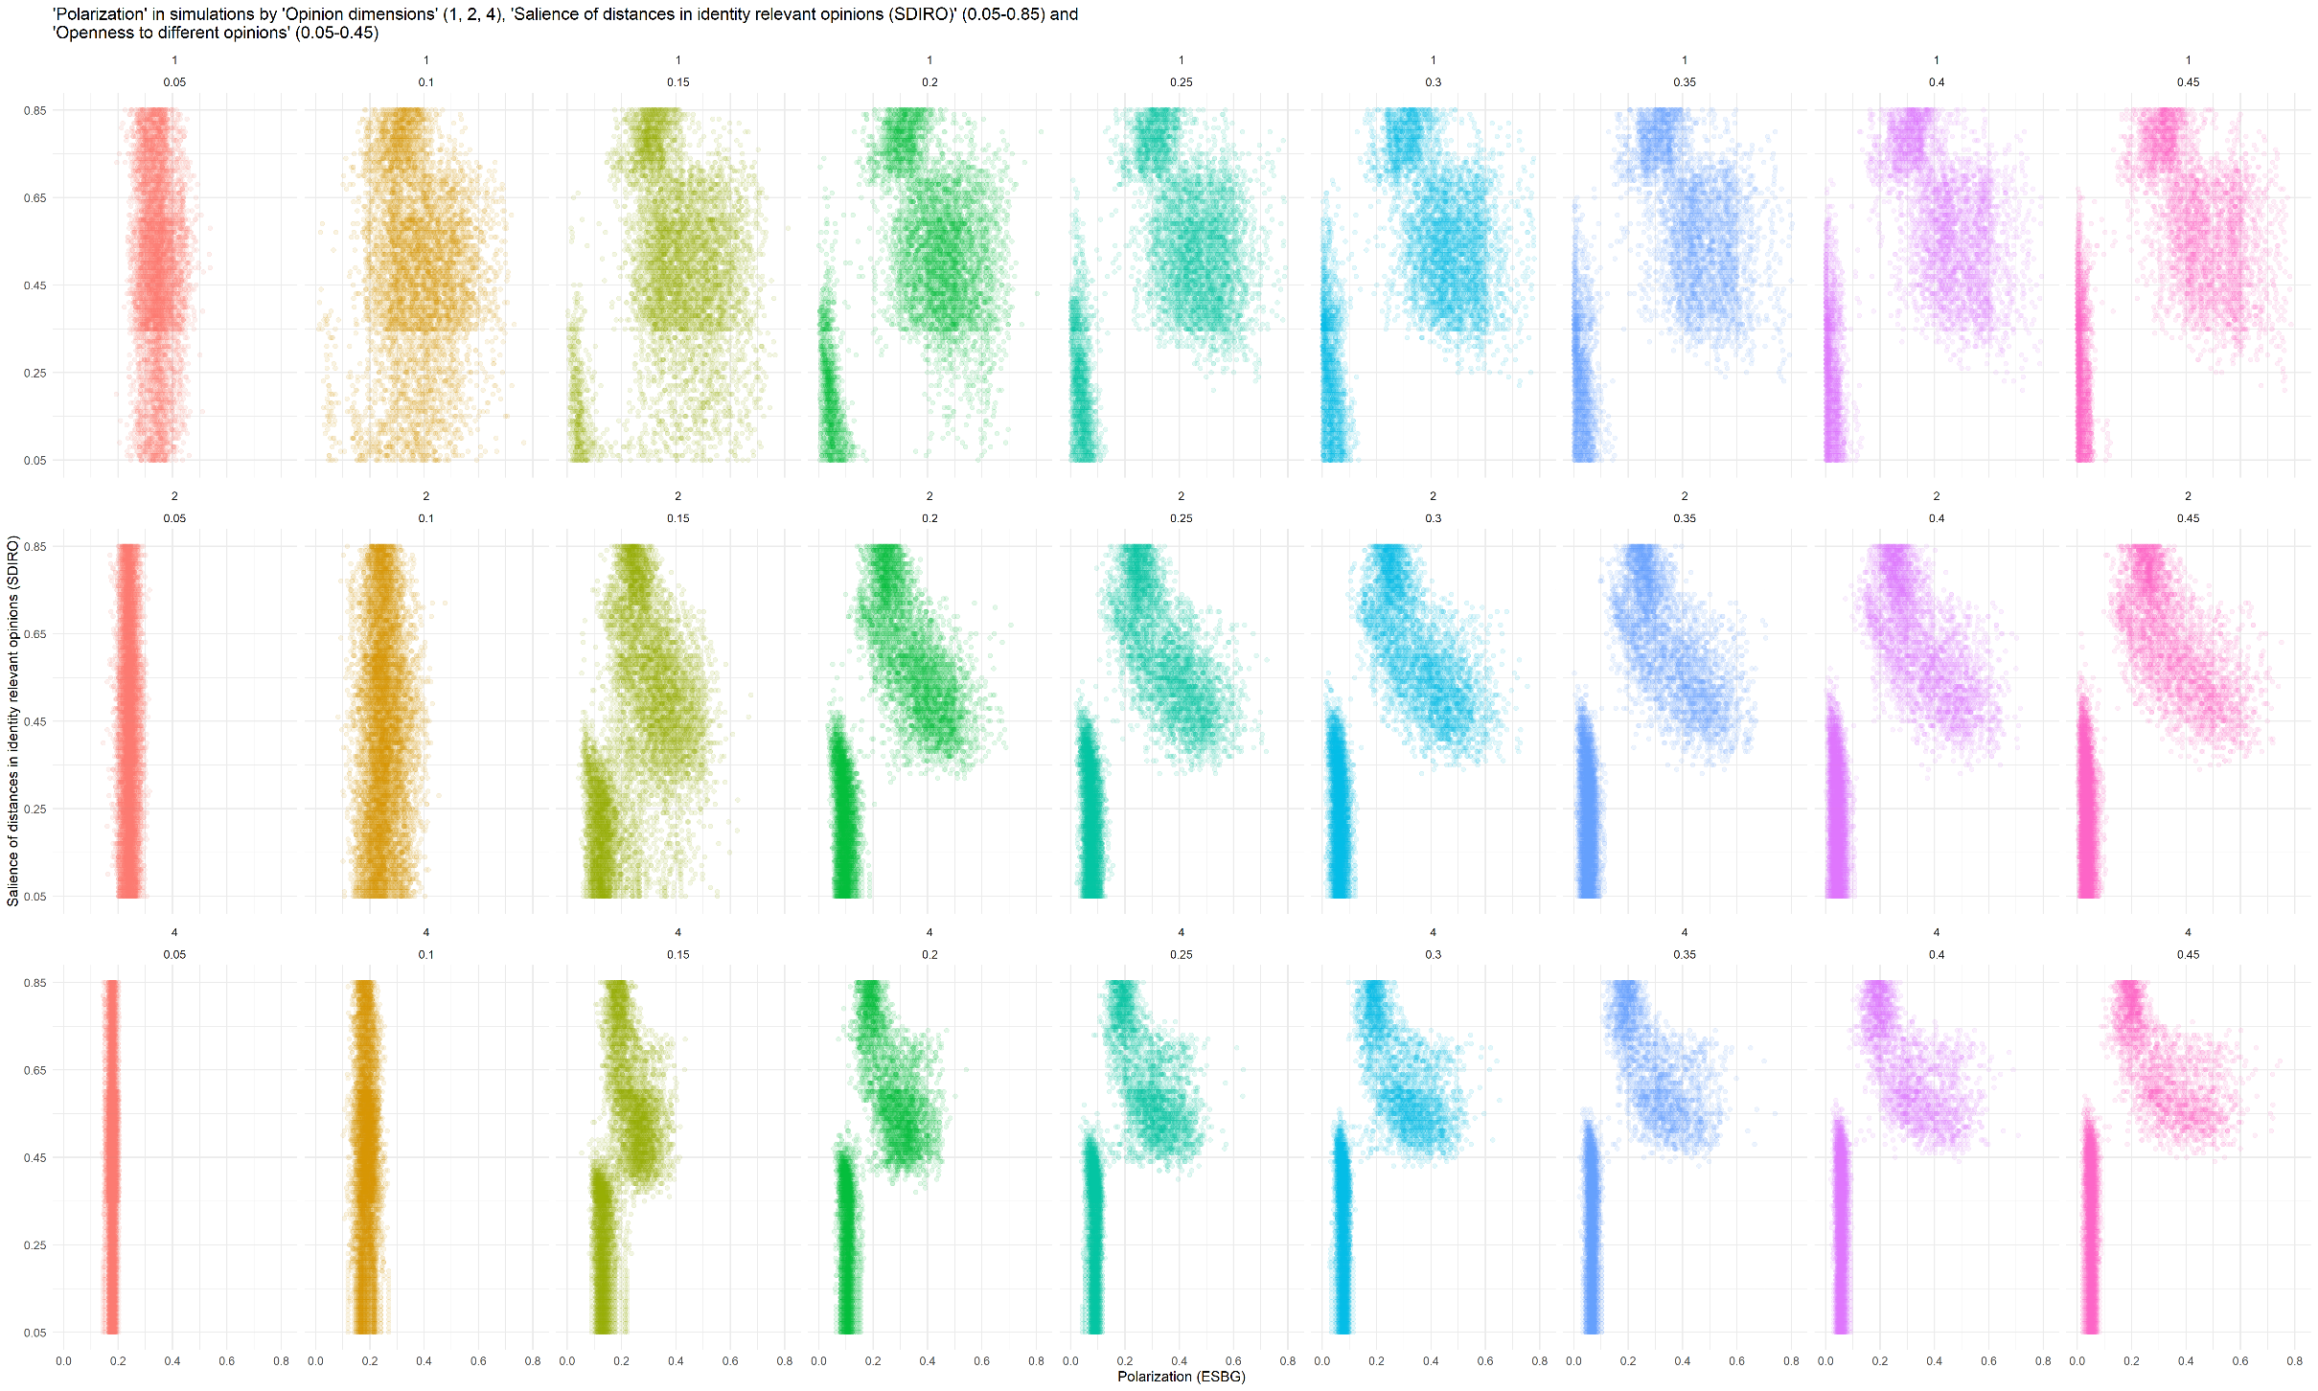

Slide 27
Thank you for your kind attention!

